Slide 1
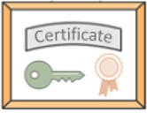
Public Key Infrastructure (PKI)

Slide 2

What do we need to establish trust?
We need a way to bind a public key to an identity!
This requires:
A set of mechanisms, format and infrastructure to “manage digital identities”
=> Public Key Infrastructure (PKI) to issue and manage Digital Certificates (Cert)
A crypto tool to authenticate certificate?
=> Digital Signature of Cert
Ensures that the public key is protected in transit

Slide 3
PKI
Public Key Infrastructure (PKI) is a set of components, policies, and protocols needed to:
Issue, validate and revoke digital certificates
Support secure exchange of public keys to establish trust
Define standard format for certificates (X.509 format)
The biggest PKI usage is secured websites using HTTPS
Notes:
A PKI specifies protocols, policies, and technical mechanisms needed to support exchange of public keys
The entire system that is formed by CAs together with the necessary support mechanisms is called a public-key infrastructure (PKI).
and manage public-key encryption
Directory services
Relation among CAs, and with end users
, distribute
Policies for issuing and REVOKING (!!) certificates

Slide 4




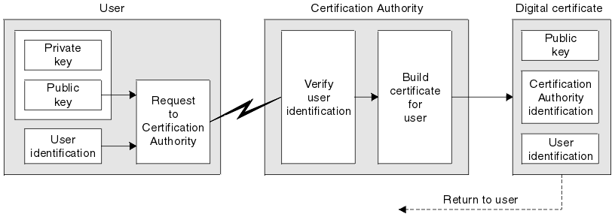
Obtaining a Digital Certificate
Alice
Return Cert signed using CA Private key
To obtain a certificate you need to create a Certificate Signing Request (CSR) and sent it to a Certificate Authority (CA)
CSR is a digital document that contains your public key and other identifying information
Once the requester identity has been verified (e.g., ownership of the domain mentioned in CSR), the CA creates a certificate and signs it with the CA private key
Anyone can now validate the certificate by checking its digital signature with the CA’s public key
Notes:
Carl uses Bob’s public key to authenticate Adam’s key
e.g., CA https://www.globalsign.com/en/
An X.509 certificate is a document used to prove ownership of a public key.
To make a new X.509 certificate you need to create a Certificate Signing Request (CSR) and sent it to a Certificate Authority (CA).
CSR is a digital document that contains your public key and other identifying information
Once your identity has been verified (e.g., ownership of the domain mentioned in CSR), the CA creates a certificate and signs it with a private key.
Anyone can now validate your certificate by checking its digital signature with the CA’s public key
The binding Alice with PK=876543 is ‘guaranteed’ by the Certificate Authority (CA)
I’m Alice, my public key is 876543
Alice need a Cert from a TRUSTED third party!
Create an Identity
An X.509 certificate is a document that is used to prove ownership of a public key. To make a new X.509 certificate you need to create a Certificate Signing Request (CSR) and give it to a Certificate Authority (CA). The CSR is a digital document that contains your public key and other identifying information. When you send a CSR to a CA it first validates that the identifying information you’ve supplied is correct, for example you may be asked to prove ownership of a domain by responding to an email. Once your identity has been verified, the CA creates a certificate and signs it with a private key. Anyone can now validate your certificate by checking its digital signature with the CA’s public key.
See posted openssl example
CA first validates that the identifying information you’ve supplied is correct, e.g., you may be asked to prove ownership of the domain.

Slide 5
Digital Certificate
A digital certificate is a document that binds a public key to the identity of the legitimate owner
→ Cert = {Owner(ID), Owner(Pub_{key}), CA digital signature of Cert}
The binding between {ID, Pub_{key}} is granted by a trusted Certification Authority (CA) that signs Cert
Provided that we have the CA’s public key, we can verify the CA signature and therefore verify the Cert authenticity
We trust CA and we have CA’s public key (e.g., In Windows use CertMgr tool to see the installed Root Certificates)
Verify CA signature on the Cert. If OK! then the Cert is authentic
Also check the certificate validity period to ensure it is NOT expired
Notes:
In order to authenticate public keys (and thus, prevent the Man in the Middle attack), all public keys are digitally signed by a central trusted authority.
Such a construction is called certificate
certificate = public key + ID(user) + CA digital signature of Cert
Acertificate for the key k_{pub} of user Alice is:
Cert(Alice) = (k_{pub}, ID(Alice), sig_{KCA}(k_{pub},ID(Alice) )
Certificates bind the identity of user to her public key
The trusted authority that issues the certificate is referred to as certificate authority (CA)
“Issuing certificates“ means in particular that the CA computes the signature sig_{KCA}(k_{pub}) using its (super secret!) private key k_{CA}
The party who receives a certificate, e.g., Bob, verifies Alice‘s public key using the public key of the CA
Identifier -> means the algorithm and parameters that were used to sign this certificate
CA issues a certificate for Alice CERT_{alice}
CERT_{alice} contains:
1) Alice name, Pub_{alice}
2) CA identity CA_{id}
3) CA signature of CERT_{alice}
NOTE: Once I have the authentic Pub_{alice}, I STILL need to verify
that the party I’m communicating with is actually Alice
This is the actual AUTHENTICATION procedure:
(and therefore the related private key)
(i.e.: it has the private key)
certificate alone is NOT sufficient!! More later…
https://hyperledger-fabric.readthedocs.io/en/release-1.2/identity/identity.html

Slide 6
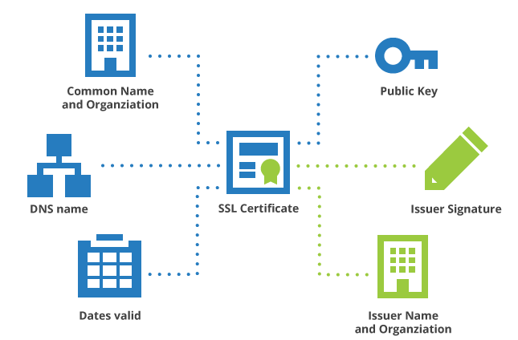
Anatomy of a Certificate
Digital Certificate

Slide 7
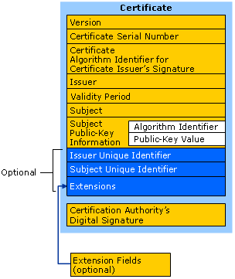
X.509 Certificate Format
X509 is a popular Cert standard that define the attributes of a certificate
CA signature is computed over all other attrributes in the certifcate (after hashing them)
Notes:
X.509 certificates: a real example - Facebook

Slide 8
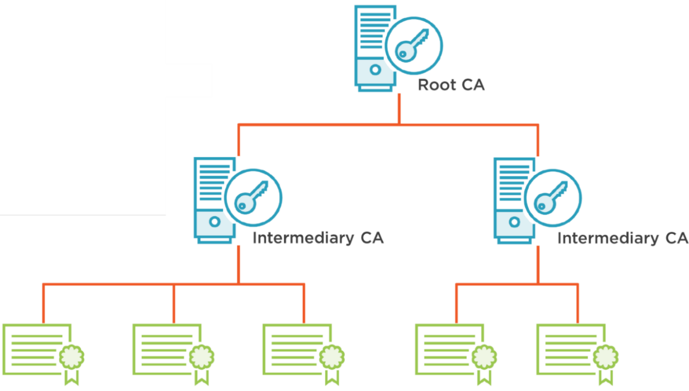
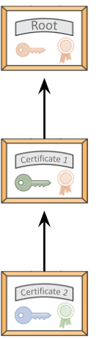
Trust Chain
Certificate of Root CA is self-signed with the Root CA private key
Certificate of Intermediate CA is signed with the Root CA private key
Issued certificates
are signed with the private key
of Issuing Intermediate CA
The Trust Chain allows anyone to check the authenticity of any certificate by examining it all the way to a well-known, trusted root certificate
Trust Chain allows a distributed trust model by enabling the ability to have multiple intermediary Cas with one master root CA
This allow more scalable solution and limits the risk if one CS is compromised
Notes:
At this point you may be wondering why you should trust the CA and how you know the public key it gave you is genuine. The CA makes it easy to prove the ownership of its public key by publishing it in an X.509 certificate. The CA’s certificate is itself signed by another CA. This sets up a chain of trust where one CA vouches for another. This chain goes back until a self-signed root certificate is reached.
There are a small number of well-known root certificates. For example you can find lists of certificates that are installed in MacOS Sierra or available to Windows computers as part of the Microsoft Trusted Root Certification Program (free TechNet account needed to view). The chain of trust allows anyone to check the authenticity of any certificate by examining it all the way to a well-known, trusted root certificate:
Microsoft Root Certificates:
https://social.technet.microsoft.com/wiki/contents/articles/51151.microsoft-trusted-root-certificate-program-participants-as-of-january-30-2018.aspx
MS Windows Certificate Tools:
https://docs.microsoft.com/en-us/windows/desktop/seccrypto/tools-to-create-view-and-manage-certificates
https://www.digicert.com/util/

Slide 9
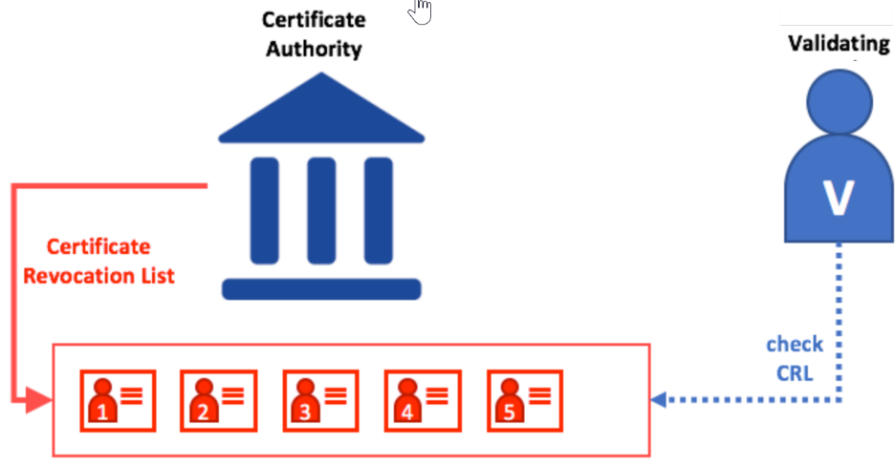
Certificate Revocation
A PKI MUST include mechanisms for revoking certificates! In case:
Public keys whose private keys have been compronised or lost
The domain was transferred to a new owner
Analogy: a credit card cancellation when lost or stolen
Explicit revocation is used. CA maintains and publishes a Certificate Revocation List (CRL) to inform client about certificates that have been revoked (i.e., no longer valid)
Client can download and periodically sync the CRL from the CA to verify whether a particular Cert is revoked.
Client
Notes:
Online Certificate Status Protocol (OCSP)
OCSP - Real-time verification but not widely used
Revocation Approach: Certificate Revocation List (CRL):
Every CA must regularly publish a list of certificates the CA has revoked
List format: must include
Issuer, Last update date, Next update date
List of serial numbers revoked, along with revocation date
CA digital signature
In principle, you SHOULD verify that the certificate of the site you are accessing has NOT been revoked
Overhead:
Online access, or offline periodic download of CRL
In practice… frequently overlooked by non critical applications
But remember, whenever you are involved in a security critical application!

Slide 10
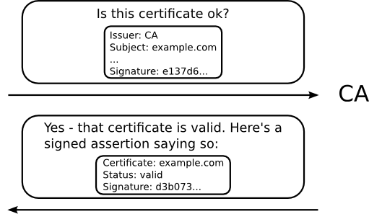
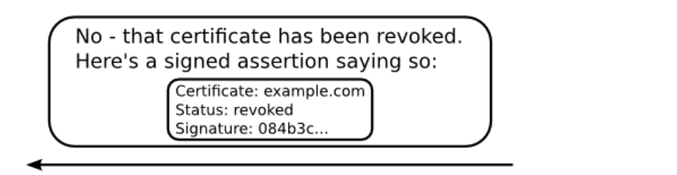
Online Certificate Status Protocol (OCSP)
OCSP enables real-time verification of the certificate status (alternative to CRLs)
If the certificate is fine, the CA can respond with a signed assertion that the certificate is still valid. Otherwise it will state that it is revoked.
Or
Notes:
Revocation information is important because at any time after a certificate has been issued, it may no longer be appropriate to trust it. For instance, maybe the CA that issued the certificate realizes it put incorrect information on it. Maybe the website operators lose control of their private key, or it gets stolen. More benignly, maybe the domain was transferred to a new owner. The Online Certificate Status Protocol (OCSP) is one method for obtaining certificate revocation information. When presented with a certificate, the browser asks the issuing CA if there are any problems with it. If the certificate is fine, the CA can respond with a signed assertion that the certificate is still valid. If it has been revoked, however, the CA can say so by the same mechanism.
https://blog.mozilla.org/security/2013/07/29/ocsp-stapling-in-firefox/

Slide 11
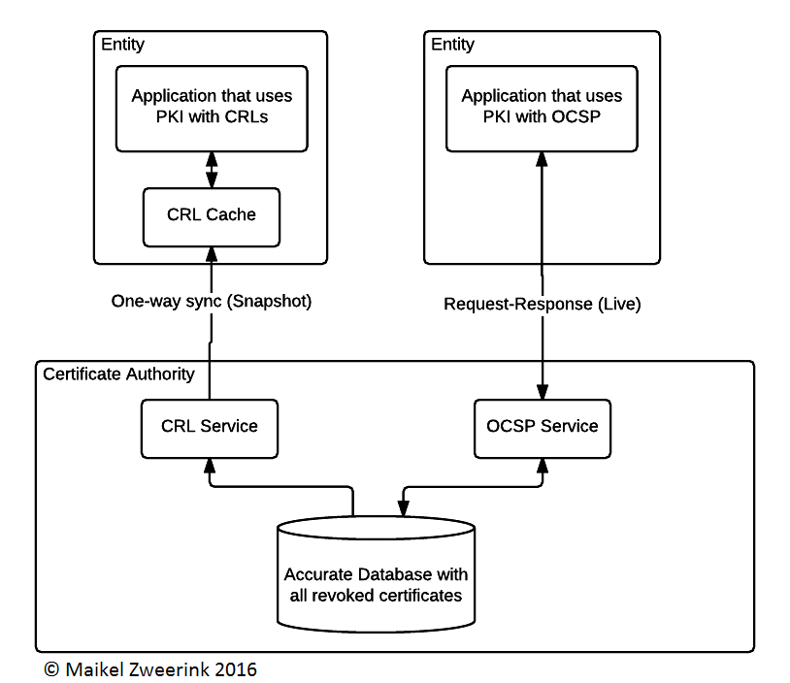
Difference between OSCP and CRL
OSCP allows direct and on demand check if a certificate is revoked.
CRLs are downloaded periodically, then locally check if a certificate is revoked.
OSCP no longer required to download CRLs and the information is more accurate. This comes at the cost of being more prone to availability attacks (such as DDoS) as the service is completely used on-demand.
Source: https://www.maikel.pro/blog/current-state-certificate-revocation-crls-ocsp/
Notes:
https://security.stackexchange.com/questions/29686/how-does-ocsp-stapling-work
Obvious advantages are that the Entity is no longer required to download the whole list of revoked certificates and the information is more accurate at the time of evaluation compared to CRLs. This comes at the cost of being more prone to availability attacks (such as DDoS) because the service is completely used on-demand.
CRLs will grow in size as time goes on, requiring a larger infrastructure over time.
Clients will only periodically sync CRLs which may cause a client to allow a certificate which is already revoked.
CRLs are prone to the availability problem, if an entity cannot request the CRL it cannot determine the status of a certificate.

Slide 12
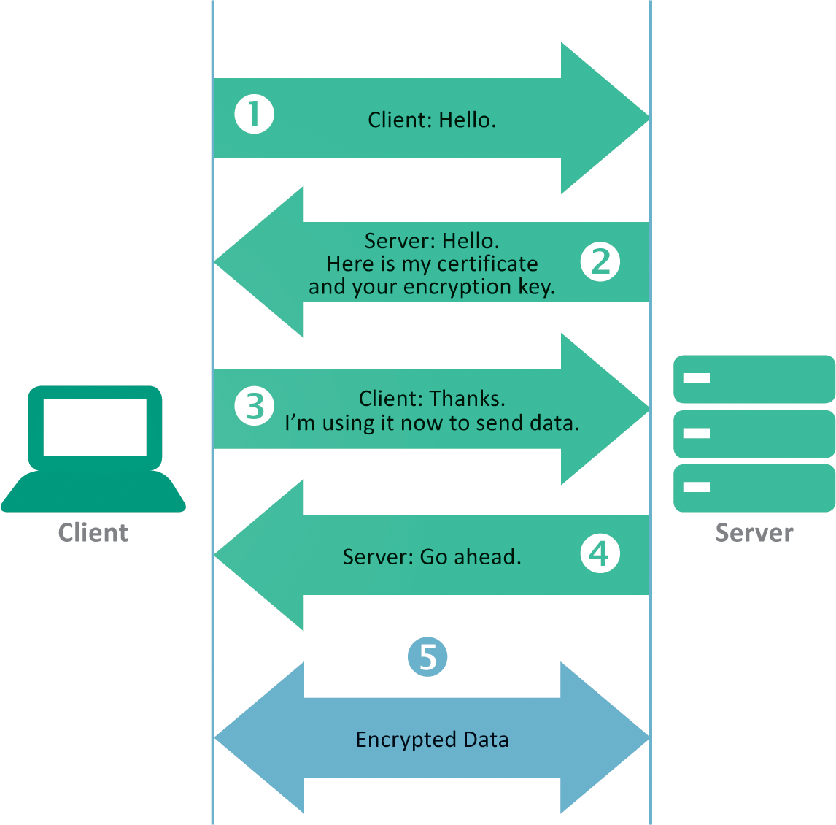
Digital Certificate in TSL Handshake (HTTPS)

Slide 13
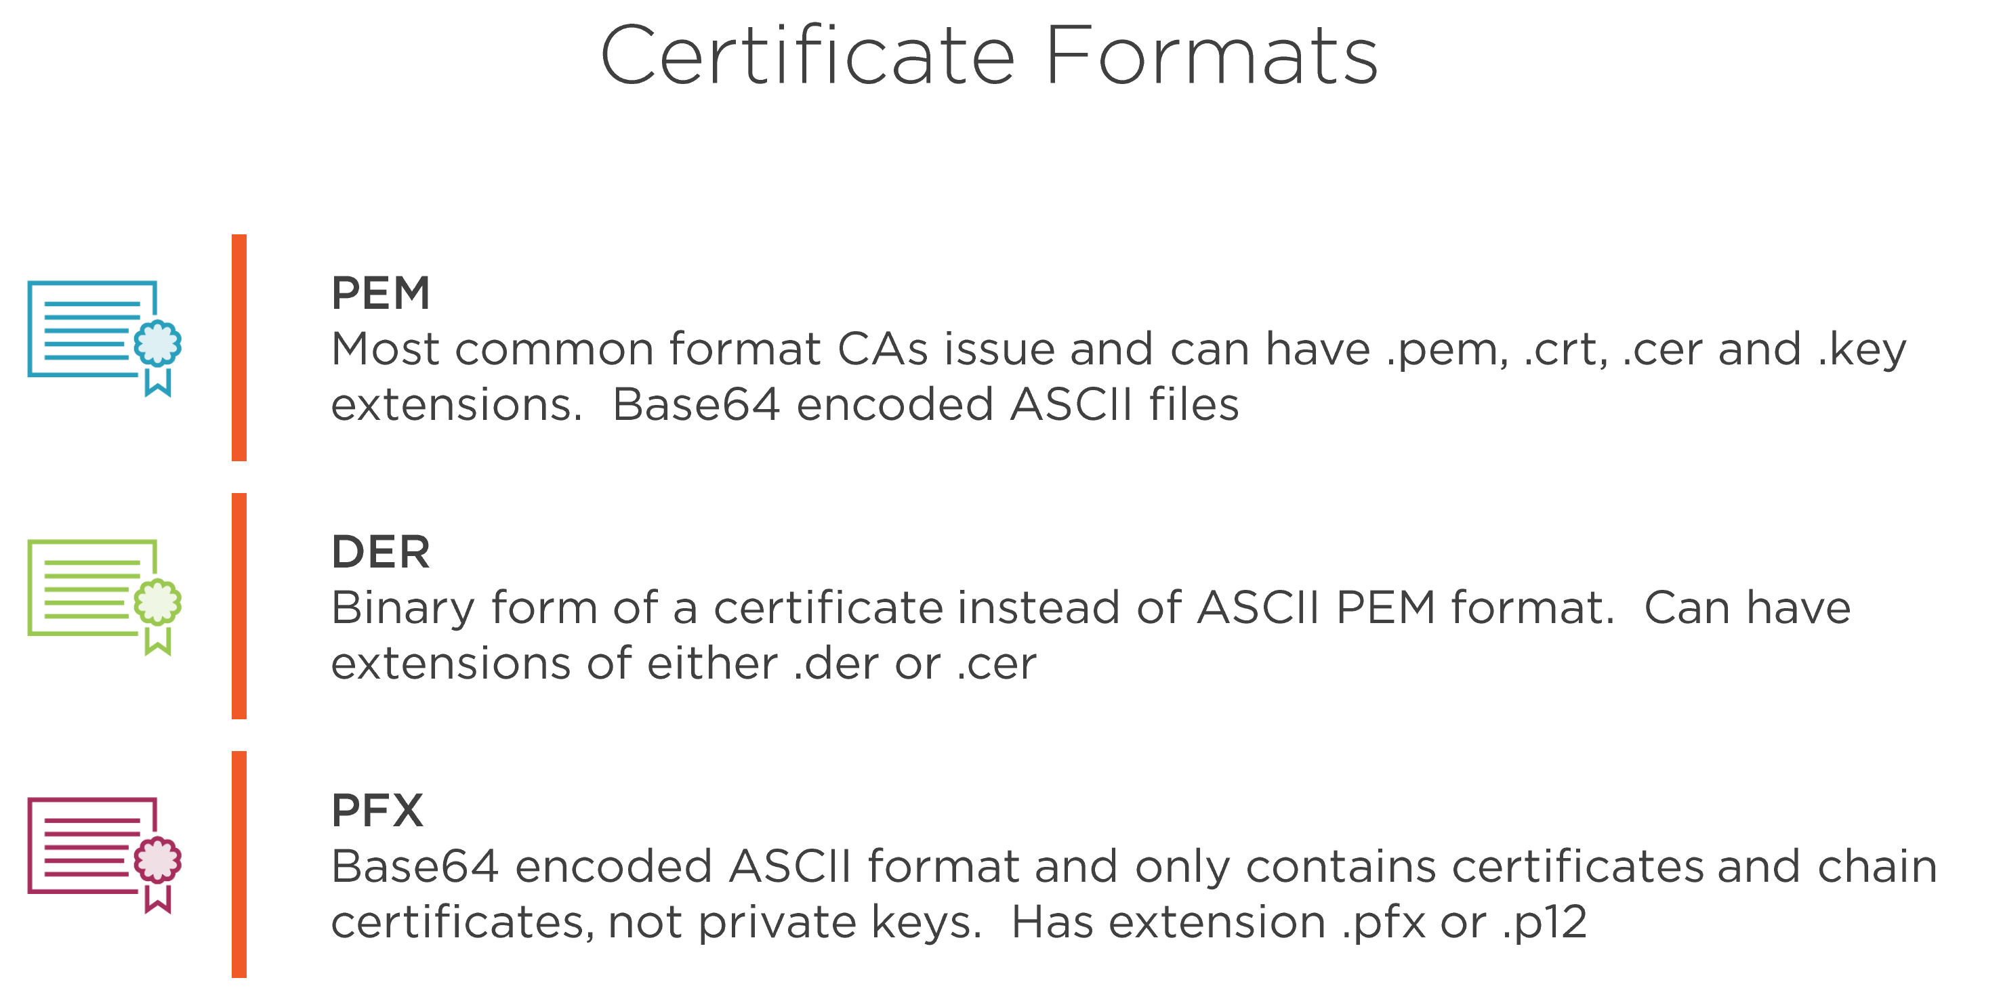

Slide 14
Resources
Digital Certificate
https://en.wikipedia.org/wiki/Public_key_certificate
Free Certificate (an alternative to Cert from CA)
https://letsencrypt.org/
Notes:
Explore Cloudflare

